Slide 1

UNIVERSITY OF MASSACHUSETTS
Dept. of Electrical & Computer Engineering
Digital Computer Arithmetic
ECE 666
Part 7
Fast Division
Israel Koren
Spring 2004

Slide 2
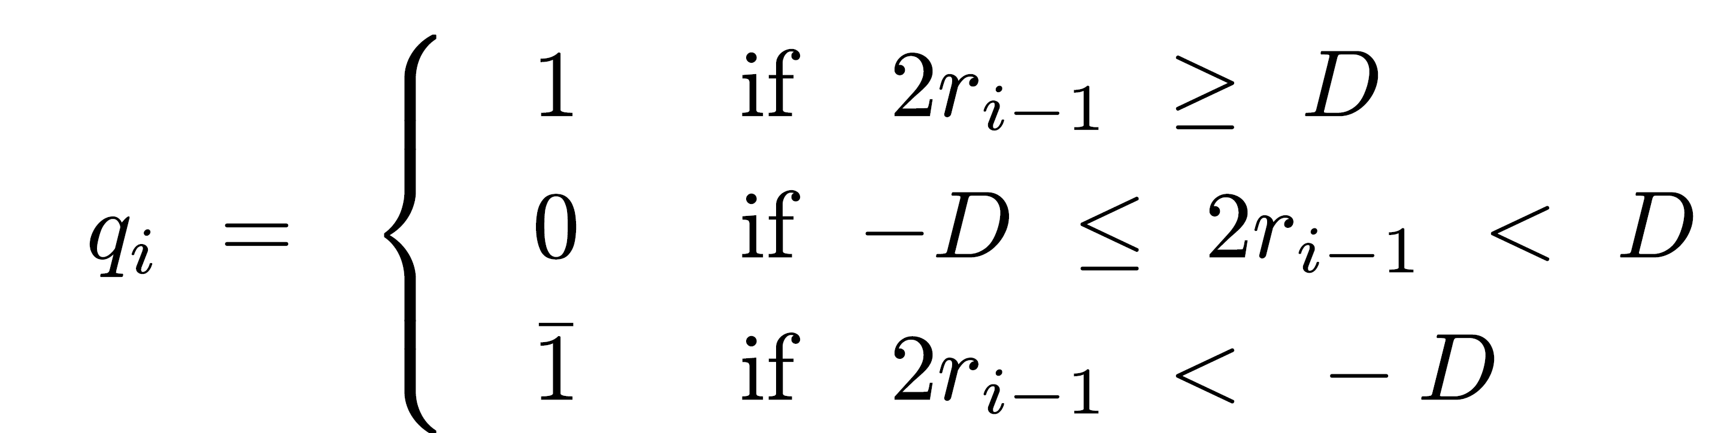

Fast Division - SRT Algorithm
2 approaches:
  First - conventional - uses add/subtract+shift, number of operations linearly proportional to word size n
  Second - uses multiplication, number of operations logarithmic in n, but each step more complex
  SRT - first approach
Most well known division algorithm - named after Sweeney, Robertson, and Tocher
Speed up nonrestoring division (n add/subtracts) - allows 0 as a quotient digit - no add/subtract:

Slide 3
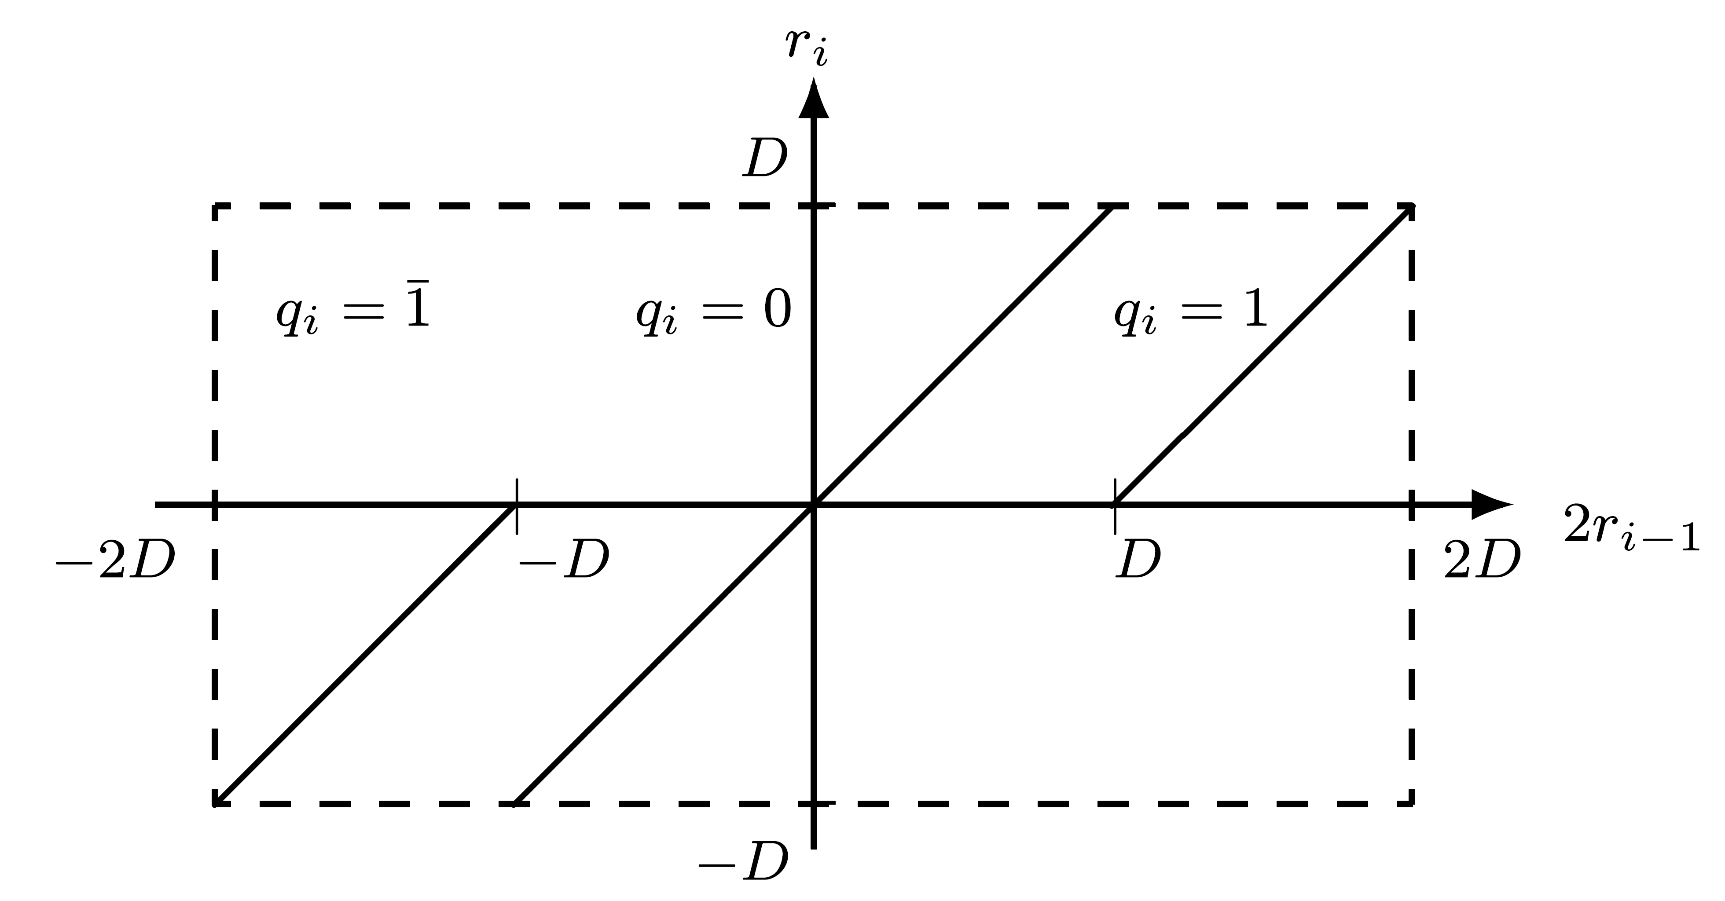
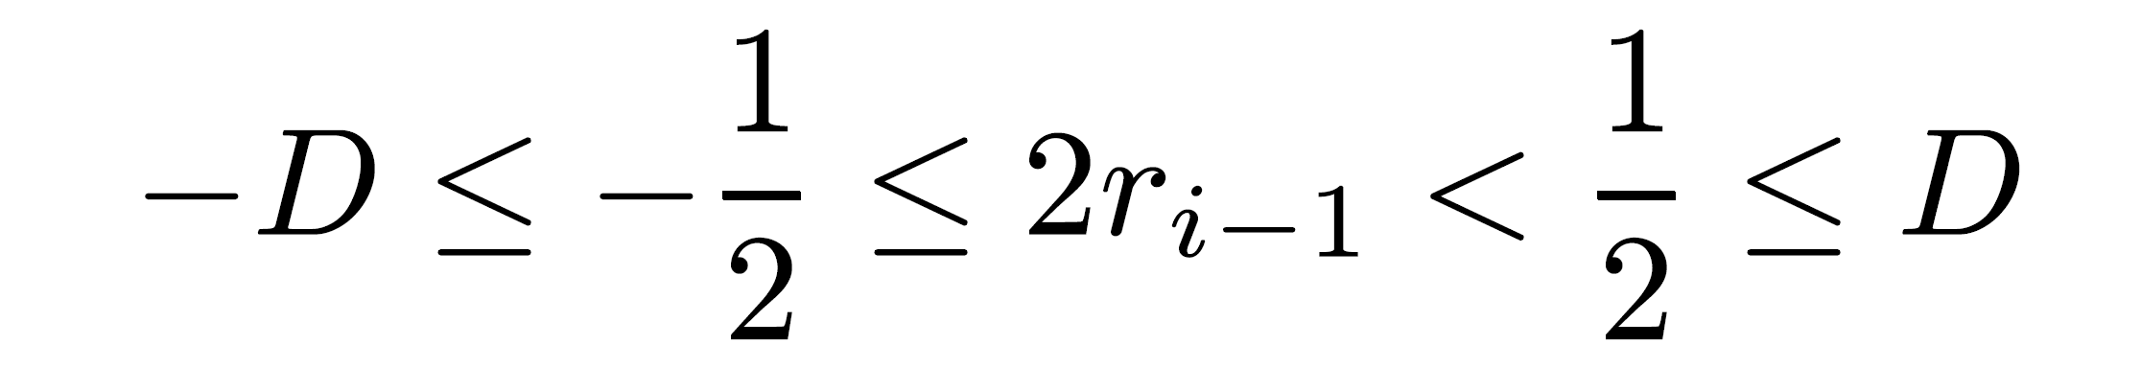
Modified Nonrestoring Division
Problem: full comparison of 2ri-1 with either D or -D required
Solution: restricting D to normalized fraction 1/2≤|D|<1
Region of 2ri-1 for which qi=0 reduced to

Slide 4
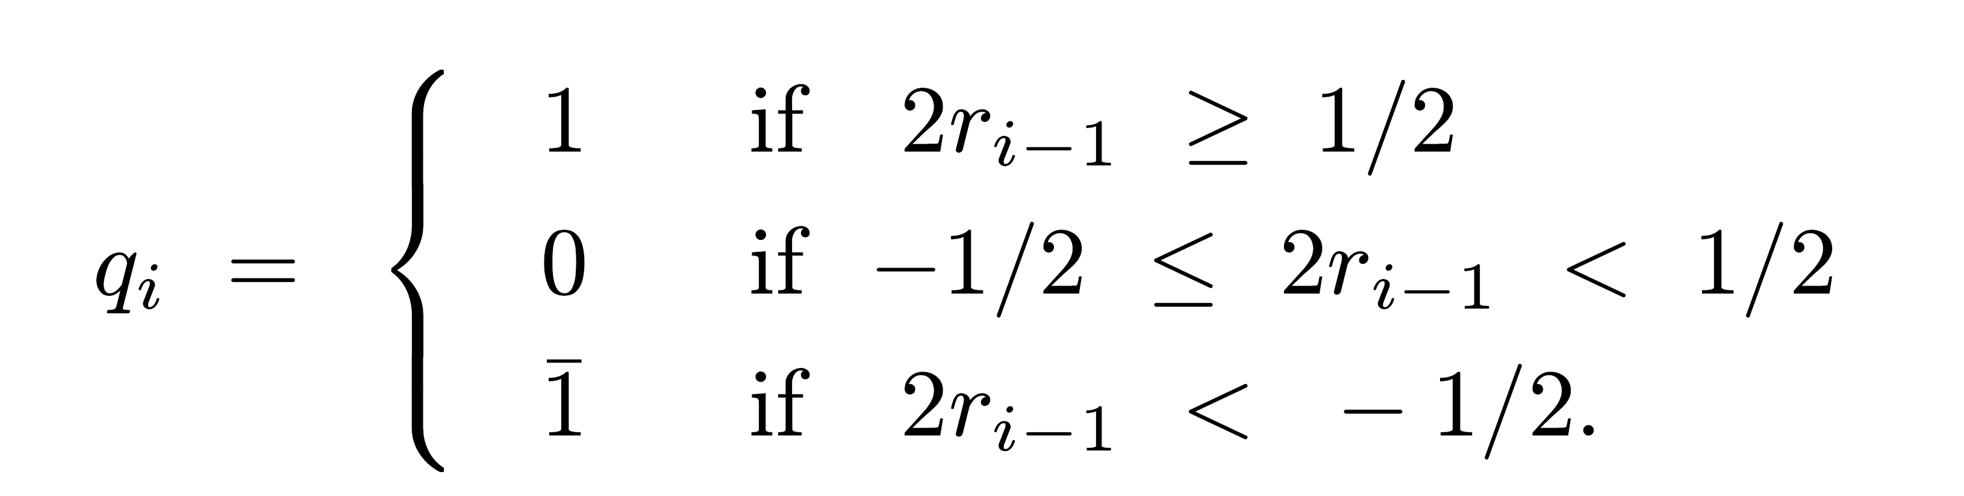
Modified Nonrestoring → SRT
Advantage: Comparing partial remainder 2ri-1 to 1/2 or -1/2, not D or -D
Binary fraction in two's complement representation
  ≥ 1/2 if and only if it starts with 0.1
  ≤ -1/2 if and only if it starts with 1.0
Only 2 bits of 2ri-1 examined - not full comparison between 2ri-1 and D
  In some cases (e.g., dividend X>1/2) - shifted partial remainder needs an integer bit in addition to sign bit - 3 bits of 2ri-1 examined
Selecting quotient digit:

Slide 5
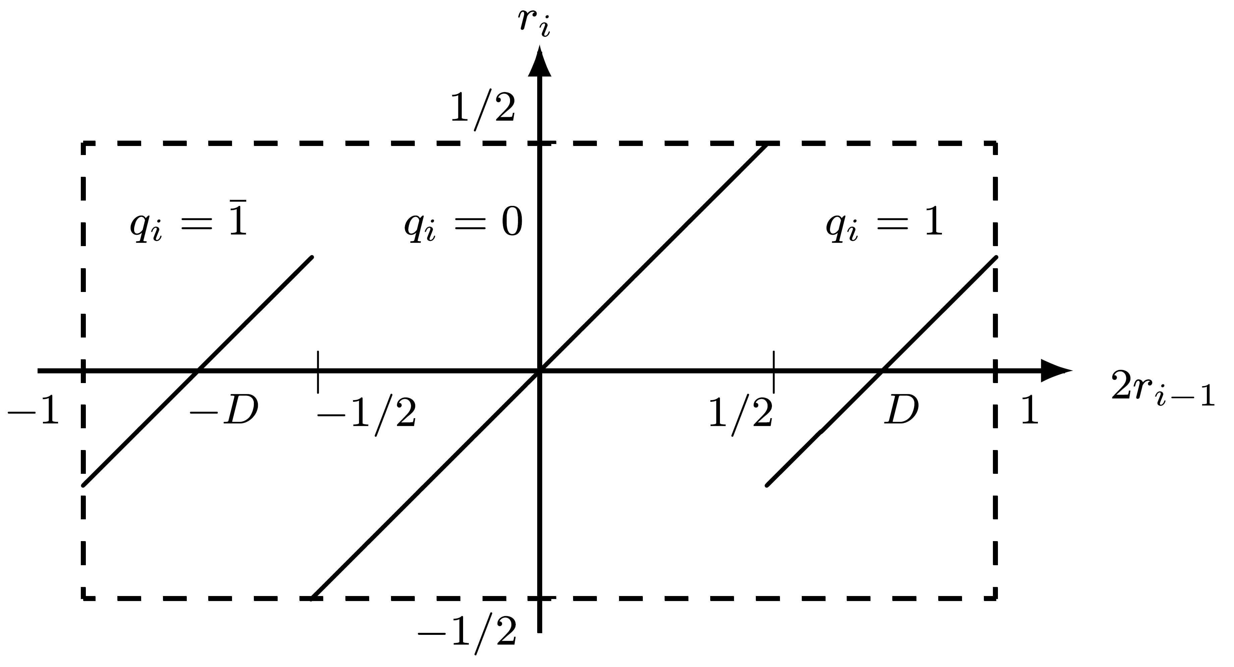
SRT Division Algorithm
Quotient digits selected so |ri| ≤ |D| ⇒ final remainder < |D|
Process starts with normalized divisor - normalizing partial remainder by shifting over leading 0's/1’s if positive/negative
Example:
  2ri-1=0.001xxxx (x - 0/1); 2ri-1<1/2 - set qi=0, 2ri=0.01xxxx and so on
  2ri-1=1.110xxxx; 2ri-1>-1/2 - set qi=0, 2ri=1.10xxxx
SRT is nonrestoring division with normalized divisor and remainder

Slide 6
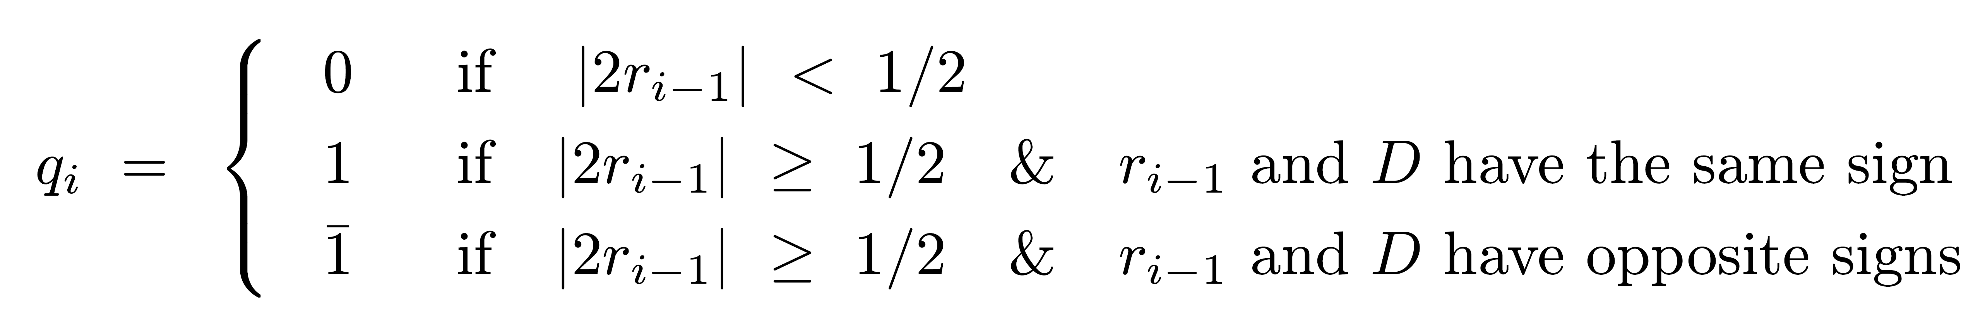
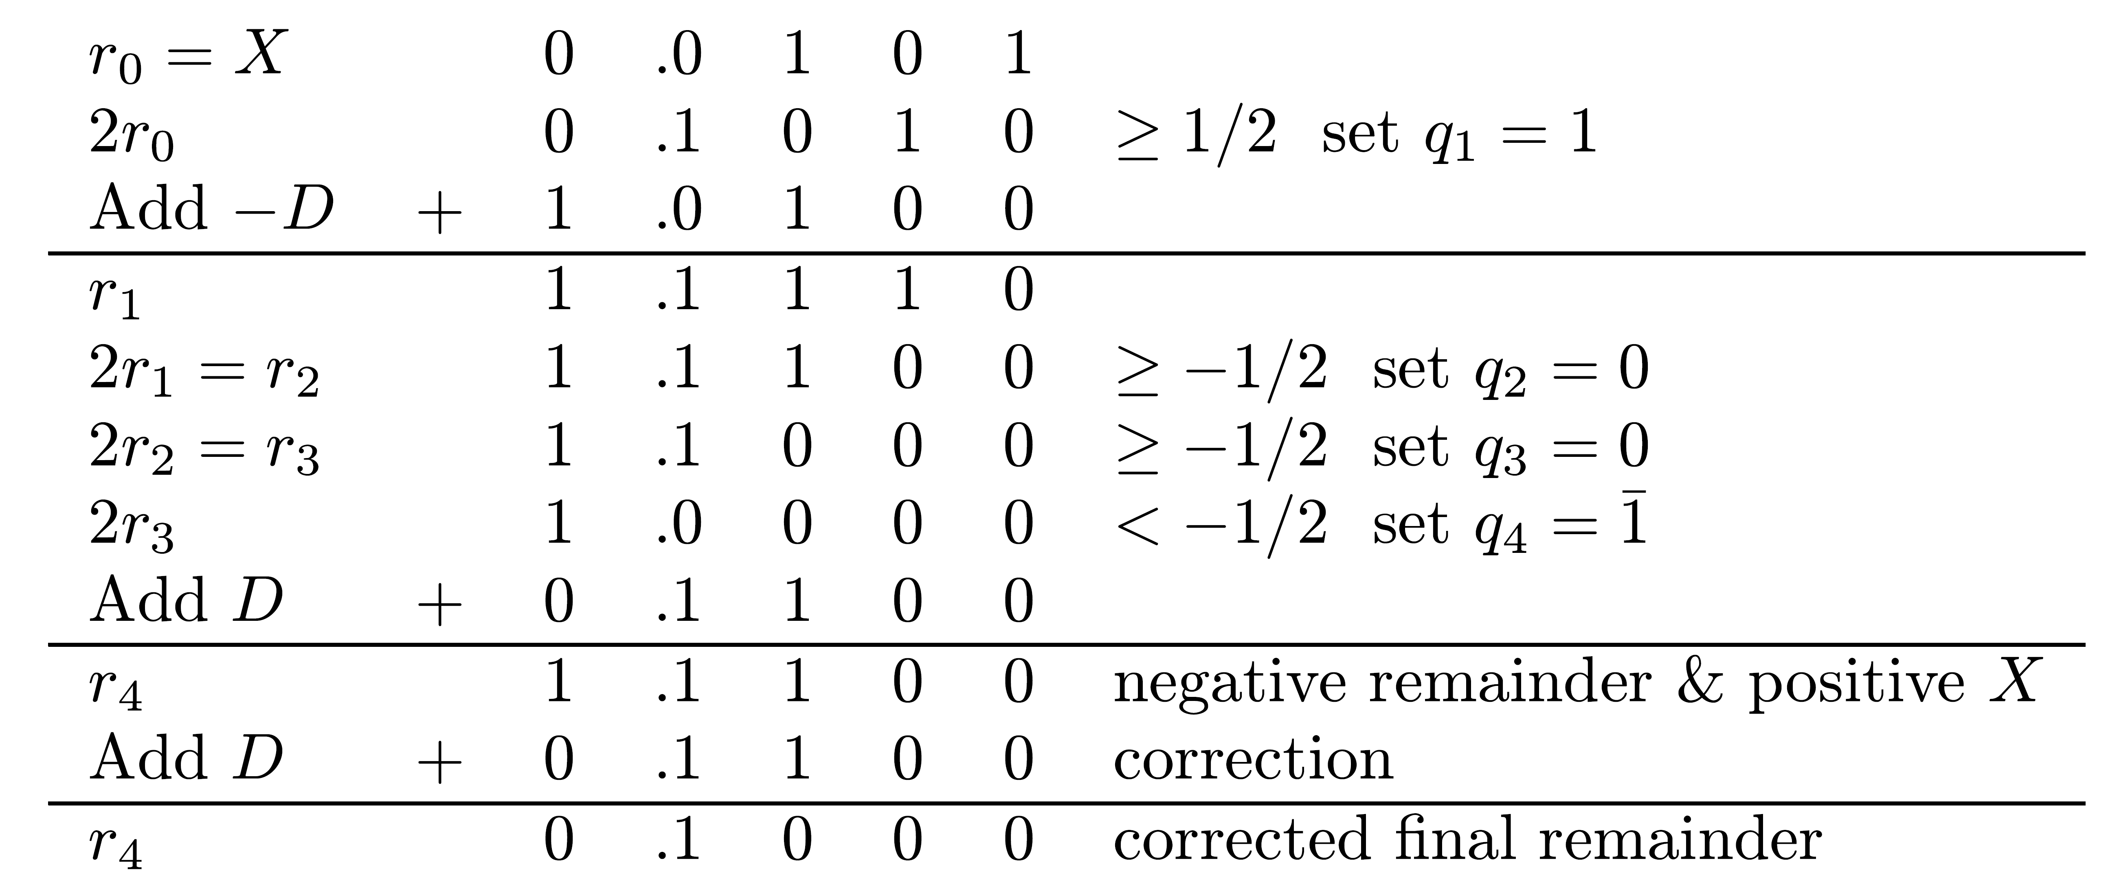
Extension to Negative Divisors
Example: Dividend X=(0.0101)2 =5/16 Divisor D=(0.1100)2 =3/4
Before correction Q=0.1001 - minimal SD repr. of Q=0.0111 - minimal number of add/subtracts
After correction, Q = 0.0111-ulp = 0.01102 = 3/8 ; final remainder = 1/2 ⋅2 =1/32
_
-4

Slide 7
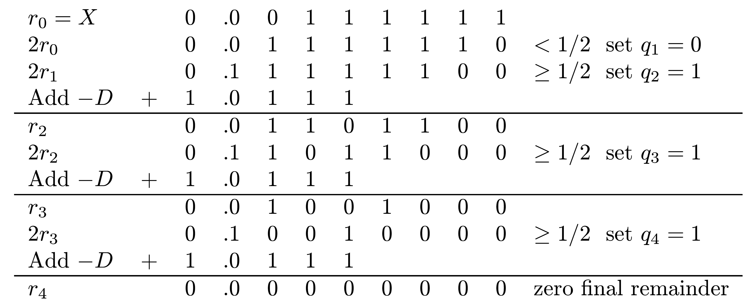
Example
X=(0.00111111)2=63/256 D=(0.1001)2=9/16
Q =0.01112=7/16 - not a minimal representation in SD form
Conclusion: Number of add/subtracts can be reduced further

Slide 8
Properties of SRT
Based on simulations and analysis:
1.Average “shift”=2.67 - n/2.67 operations for dividend of length n
  24/2.67 ~ 9 operations on average for n=24
2.Actual number of operations depends on divisor D - smallest when 17/28 ≤ D ≤ 3/4 - average shift of 3
If D out of range (3/5 ≤ D ≤ 3/4) - SRT can be modified to reduce number of add/subtracts
2 ways to modify SRT

Slide 9
Two Modifications of SRT
Scheme 1: In some steps during division -
  If D too small - use a multiple of D like 2D
  If D too large - use D/2
  Subtracting 2D (D/2) instead of D - equivalent to performing subtraction one position earlier (later)
Motivation for Scheme 1:
  Small D may generate a sequence of 1's in quotient one bit at a time, with subtract operation per each bit
  Subtracting 2D instead of D (equivalent to subtracting D in previous step) may generate negative partial remainder, generating sequence of 0's as quotient bits while normalizing partial remainder
Scheme 2: Change comparison constant K=1/2 if D outside optimal range - allowed because ratio D/K matters - partial remainder compared to K not D

Slide 10
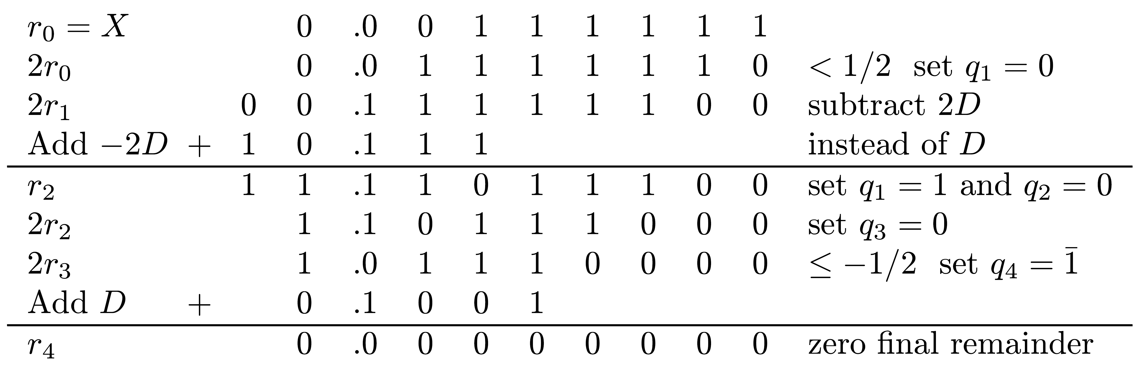
Example - Scheme 1 (Using 2D)
Same as previous example -
X=(0.00111111)2=63/256 D=(0.1001)2=9/16
Q =0.10012=7/16 - minimal SD representation
_

Slide 11
Scheme 1 (Using D/2)
Large D - one 0 in sequence of 1's in quotient may result in 2 consecutive add/subtracts instead of one
Adding D/2 instead of D for last 1 before the single 0 - equivalent to performing addition one position later - may generate negative partial remainder
Allows properly handling single 0
Then continue normalizing partial remainder until end of sequence of 1's

Slide 12
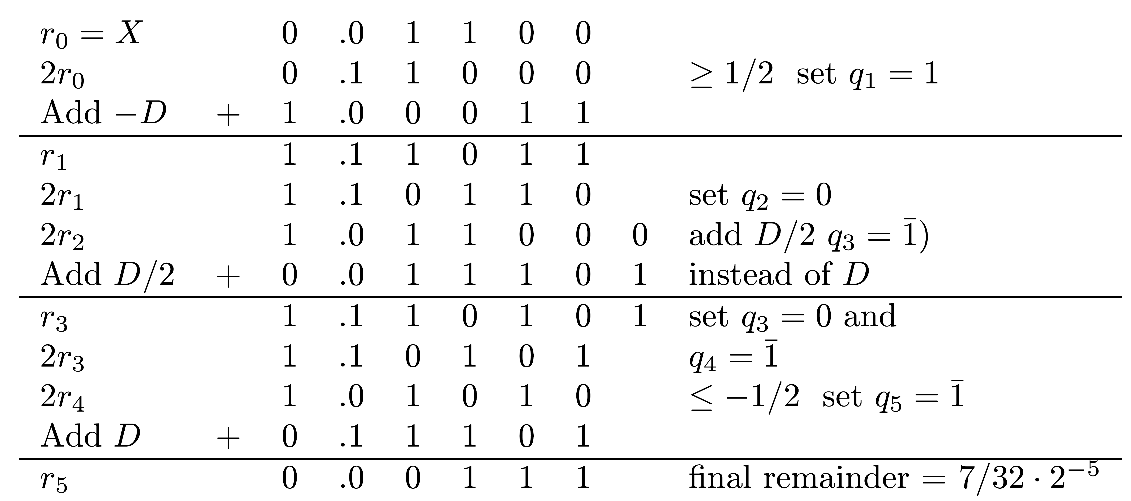
Example
X=(0.01100)2=3/8 ; D=(0.11101)2=29/32
Correct 5-bit quotient - Q=(0.01101)2=13/32
Applying basic SRT algorithm - Q=0.10111 - single 0 not handled efficiently
Using multiple D/2 -
Q =(0.10011)2=13/32 - single 0 handled properly
-
-
_
_

Slide 13
Implementing Scheme 1
Two adders needed
  One to add or subtract D
  Second to add/subtract 2D if D too small (starts with 0.10 in its true form) or add/subtract D/2 if D too large (starts with 0.11)
Output of primary adder used, unless output of alternate adder has larger normalizing shift
Additional multiples of D possible - 3D/2 or 3D/4
Provide higher overall average shift - about 3.7 - but more complex implementation

Slide 14
Modifying SRT - Scheme 2
For K=1/2, ratio D/K in optimal range 3/5≤D≤3/4 is
6/5 ≤ D/K = D/(1/2) ≤ 3/2 or (6/5)K ≤ D ≤ (3/2)K
If D not in optimal range for K=1/2 - choose a different comparison constant K
Region 1/2 ≤ |D|<1 can be divided into 5 (not equally sized) sub-regions
Each has a different comparison constant Ki

Slide 15
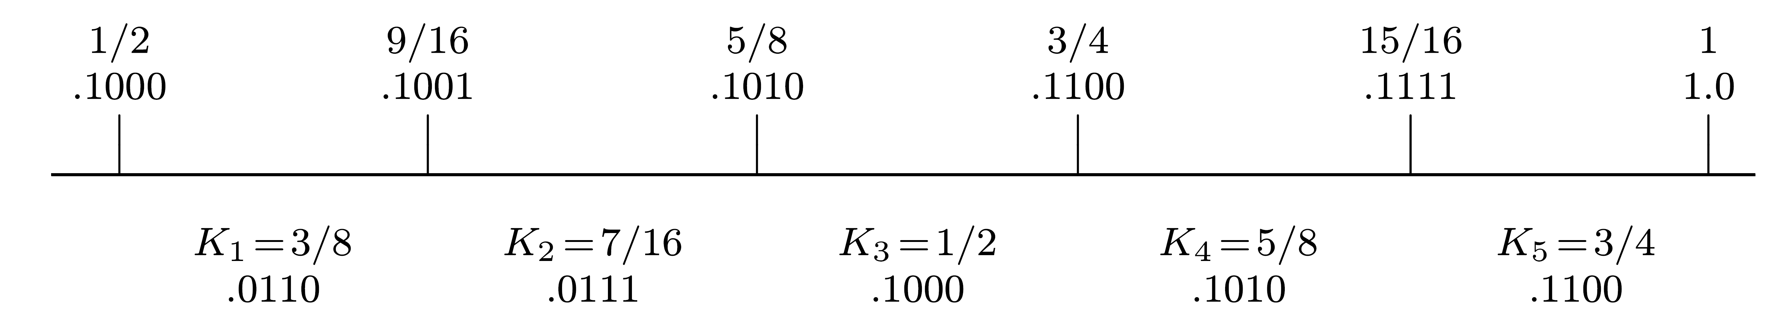
Division into Sub-regions
4 bits of divisor examined for selecting comparison constant
It has only 4 bits compared to 4 most significant bits of remainder
Determination of sub-regions for divisor and comparison constants - numerical search
Reason: Both are binary fractions with small number of bits to simplify division algorithm

Slide 16
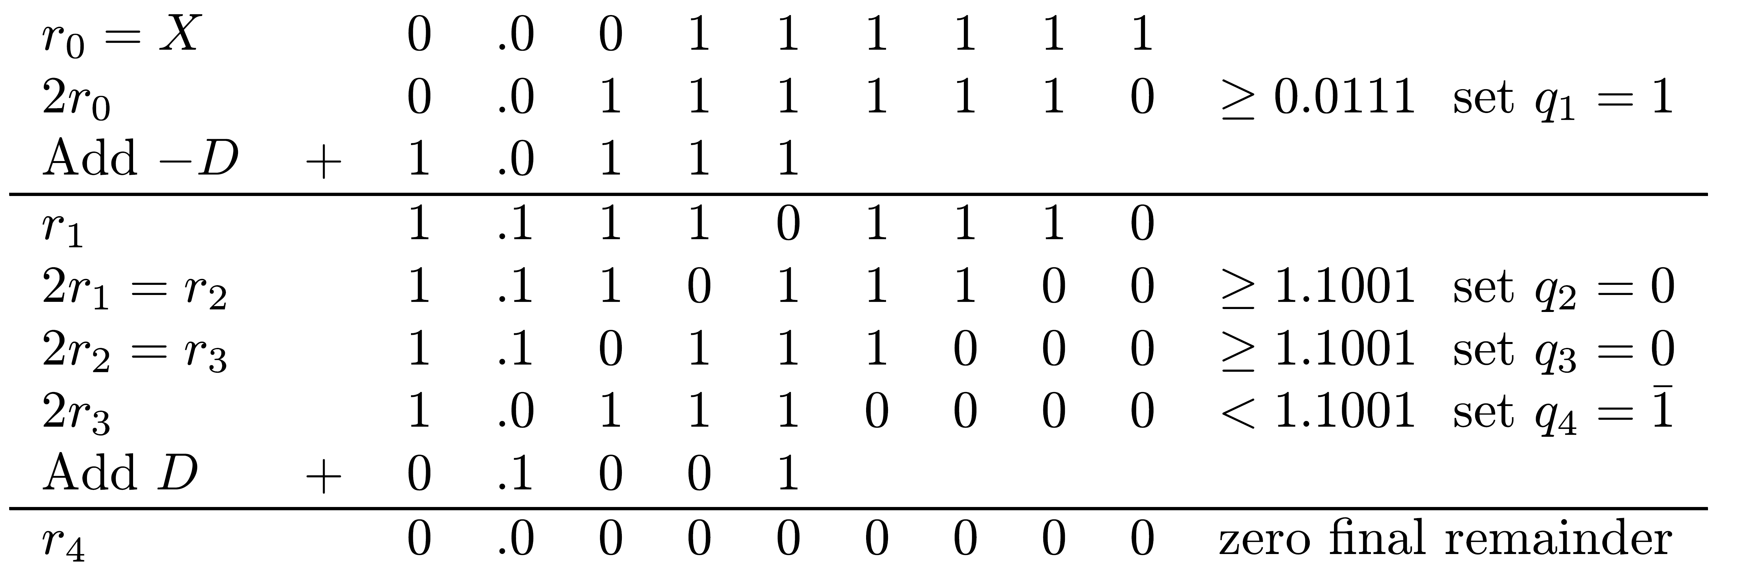
Example
X=(0.00111111)2=63/256 ; D=(0.1001)2=9/16
Appropriate comparison constant - K2=7/16=0.01112
If remainder negative - compare to two's complement of K2 =1.10012
Q=0.1001=0.01112=7/16 - minimal SD form
_

Slide 17
High Radix Division
  Number of add/subtracts in radix-2 SRT is data-dependent
  Asynchronous circuit needed to use reduced number of nonzero bits in quotient
  Increasing number of 0’s in quotient - limited practical significance
Number of add/subtracts reduced by increasing radix β
  β = 2 - m quotient bits generated each step
  Number of steps reduced to ⎡n/m⎤
Recursive equation for remainder -
ri = β ri-1 - qi D
  Multiply by β=2 - shift left remainder by m bit positions
Digit set for quotient:
  0,1,...,β-1 for restoring division
  Up to β-1,...,1,0,1,...,β-1 for high-radix SRT division
m
m

Slide 18
High Radix Restoring Division
All previous division algorithms can use radix > 2
Restoring division -
  Initial guess qi=1
  If remainder βri-1-D>0 - increase to qi=2
  Subtract D from temporary remainder: βri-1-2D
  Repeat until qi=j: temporary remainder βri-1-jD negative
  Remainder restored by adding D: βri-1-(j-1)D ; qi=j-1
Time-consuming - no advantage over binary algorithm
Can be parallelized by circuits comparing βri-1 to several multiples jD - selecting smallest positive remainder; substantial hardware requirement
Binary nonrestoring division - similar changes

Slide 19
High-Radix SRT Algorithm
Faster than binary version
Quotient digit qi - signed digit in range α,α-1,…,1,0,1,...α, where ⎡1/2(β-1)⎤ ≤ α ≤ β-1
Finding possible choices for α in high-radix division:
Quotient digit qi selected so that |ri| < |D|; otherwise, next quotient digit may be β or larger
  Guarantees convergence of division procedure
  For maximal remainder ri-1=D-ulp and positive D, largest value for qi=α should guarantee ri in allowable region

Slide 20
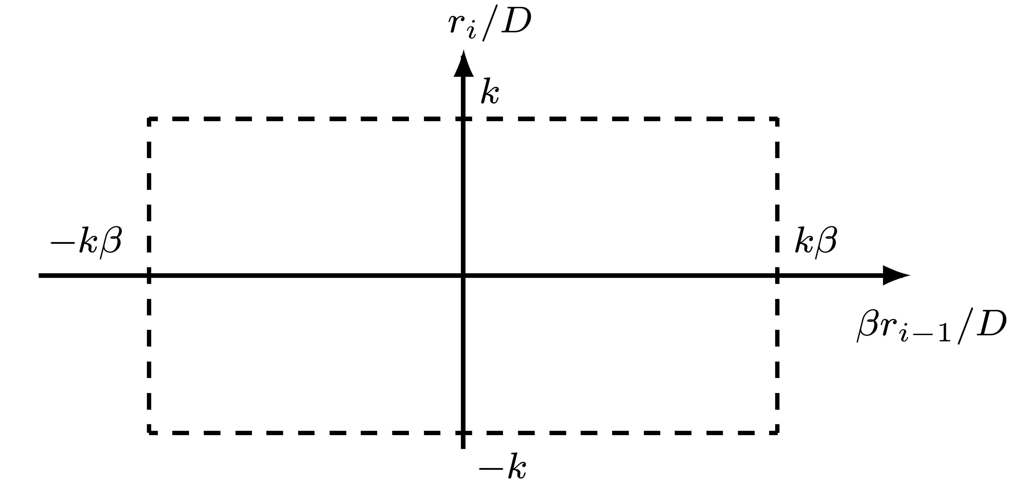
Reducing Remainder Range
ri = β (D-ulp) - αD ≤ D-ulp
Select for α only maximum value β-1
May consider division where |ri| ≤ k|D|, ( k is a fraction)
  reduce size of allowable region for remainder:
ri =β k(D-ulp)-αD ≤ k(D-ulp)
α ≥ k(β-1) ⇒ k ≤ α/(β-1)
  1/2 ≤ k ≤ 1 allows selection of any α in ⎡(β-1)/2⎤ ≤ α ≤ β-1
  Larger k ⇒ larger redundancy for quotient

Slide 21
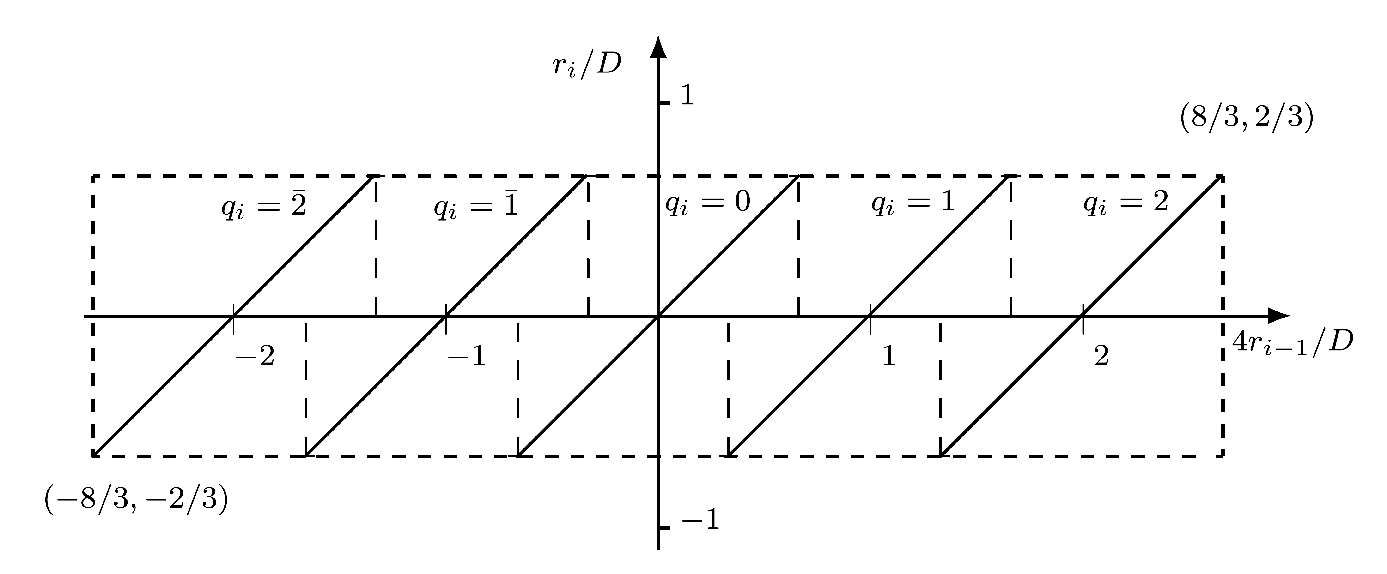
Example
β=4 ; α=2 ; k=α/(β-1) = 2/3
  |ri| ≤ kD = 2/3 D ; |βri-1| = |4ri-1| ≤ 8/3 D or |ri/D| ≤ 2/3 and |4ri-1/D| ≤ 8/3
Digit set for qi ={2,1,0,1,2}
Region for selecting q : -2/3 ≤ 4ri-1/D - q ≤ 2/3 or -2/3 +q ≤ 4ri-1/D ≤ 2/3 +q
Region examples:
  For selecting qi=2 : 4/3 ≤ 4ri-1/D ≤ 8/3
  For selecting qi=1 : 1/3 ≤ 4ri-1/D ≤ 5/3
  Overlapping region: 4/3 ≤ 4ri-1/D ≤ 5/3 select either qi=1 or qi=2
  Similar overlapping regions exist for any 2 adjoining digits
_
_

Slide 22
Measure of Redundancy
Ratio k=α/(β-1) - measure of redundancy in representation of quotient
  Larger k ⇒ larger overlap regions in plot of ri/D vs βri-1/D
Example: α=3; β=4; k=1 - maximum redundancy
  Region for qi=1 : 0 ≤ 4ri-1/D ≤ 2,
  Region for qi=2 : 1 ≤ 4ri-1/D ≤ 3
  Overlapping region : 1 ≤ 4ri-1/D ≤ 2
Larger than overlap region for α=2;β=4; k=2/3:

Slide 23
Implication of Overlap Region
Provides choice of comparison constants for partial remainder and divisor
  Can be selected to require as few digits as possible
  Reducing execution time of comparison step when determining quotient digit
Larger α ⇒ larger overlap region ⇒ larger choice ⇒ fewer digits
On the other hand, larger α ⇒ more αD multiples ⇒ extra hardware and/or time required
For given α - determining number of bits of partial remainder and divisor to be examined is the most difficult step when developing high-radix SRT
  Can be done numerically, analytically, graphically, or by combination of techniques

Slide 24
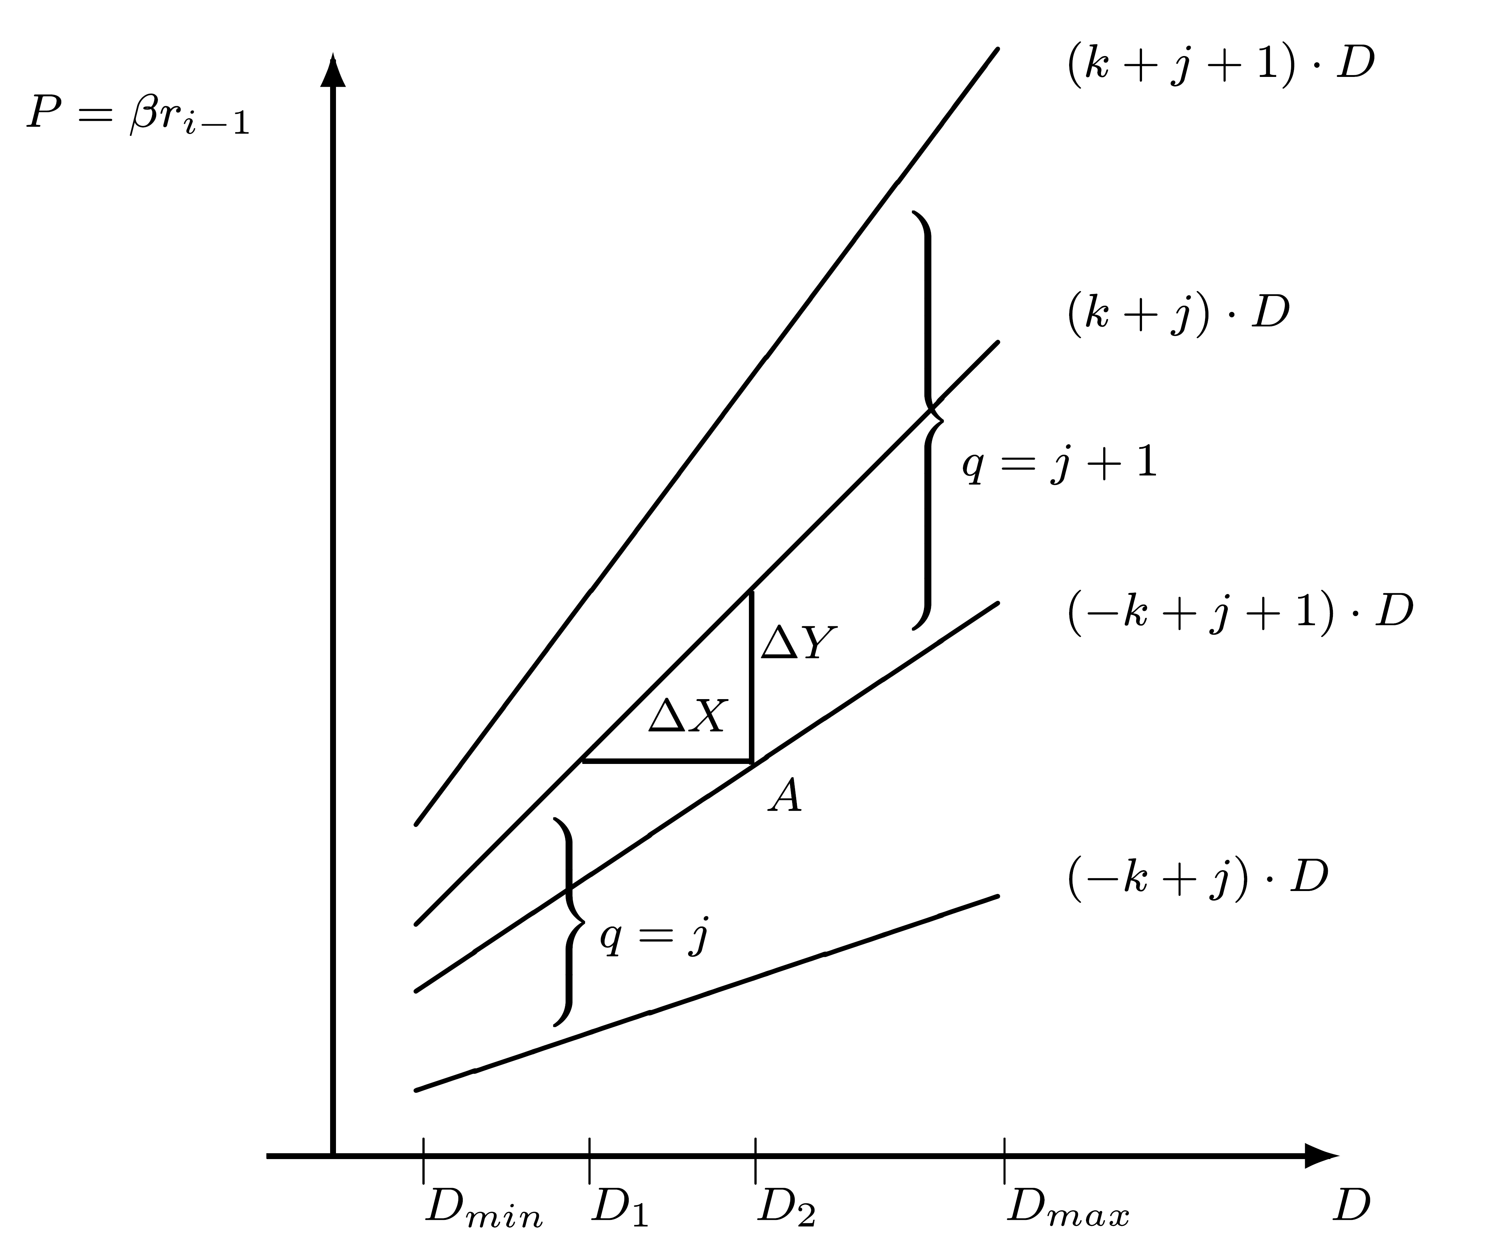
Graphical Approach: P-D Plot
Basic equation for partial remainder - βri-1=ri+qiD
Notation: P = previous partial remainder βri-1
  Partial remainder vs. Divisor plot - indicates regions in which given values of q may be selected
  Limits on P for given q:
  - k D ≤ ri ≤ k D
  Pmin=(-k+q)D ; Pmax=(k+q)D
  Regions for q=j and q=j+1 overlap
  Only positive values of divisor and partial remainder - 1/4 of complete P-D plot - plot symmetric about both axes
  Only values of |D| in [Dmin,Dmax] are of interest - e.g. [0.5,1);[1,2) (IEEE floating-point)

Slide 25
Separating Selection Regions
Value of P separating selection regions of q=j & q=j+1
  Serves as comparison constant
  Its number of bits determines necessary precision when examining partial remainder to select q
Line separating regions is horizontal (P=c ; selection of q independent of D) if and only if
(k+j)Dmin ≥ c ≥ (-k+j+1)Dmax
Otherwise - line is stairstep:
  partitioning [Dmin,Dmax) into sub-intervals
  “Stepping” points determine precision - number of digits - of examining D
  Height of steps determines precision of examining partial remainder

Slide 26
Determining Precision
Notation: ΔX (ΔY) - maximum width (height) of a step between D1 and D2
  Horizontal (vertical) distance between the 2 lines defining overlap region
ΔX=D2-D1=P/(-k+j+1)-P/(k+j) =P(2k-1)/[j(j+1)+k(1-k)]
  ΔX minimal when j is max and P is min
  jmax=α-1; P minimal when D1=Dmin
  ΔXmin=Dmin(k+α-1)(2k-1)/ [α(α-1)+k(1-k)]
  ΔY=(k+j)D-(-k+j+1)D=(2k-1)D
  ΔY is minimal when D = Dmin
It is sufficient to consider overlapping region between q=α and q=α-1 near Dmin

Slide 27
Precision - Cont.
Notation: NP (ND) - number of examined bits of partial remainder (divisor) ; εP (εD) - number of fractional bits in NP (ND)
Selecting q - look-up table implemented in a PLA (programmable logic array) with NP+ND inputs
Minimizing size of look-up table speeds up division
Precision of partial remainder (“truncated” divisor) - 2 (2 )
2 ≤ ΔXmin ; 2 ≤ ΔYmin
Only upper bounds for precision - the 2 extreme points ΔX,ΔY may require higher precision - more than εP,εD fractional bits
-εp
-εD
-εD
-εp

Slide 28
Using P-D Plot
  To determine precision
  To select q for each P,D when truncated to NP,ND bits
  Limited precision taken into account
Point (P,D) represents all partial remainder-divisor pairs with P ≤ partial remainder ≤ P+2 D ≤ divisor ≤ D+2
Selected q must be legitimate for all pairs in range
Example: Point A
Divisor=D2 - select q=j+1 ; divisor=D2+2 - select q=j
Conclusion: do not select q=j+1 for point A or any other point in overlap region whose horizontal distance from the line (-k+j+1)D ≤ 2
-εp
-εD
-εD
-εD

Slide 29
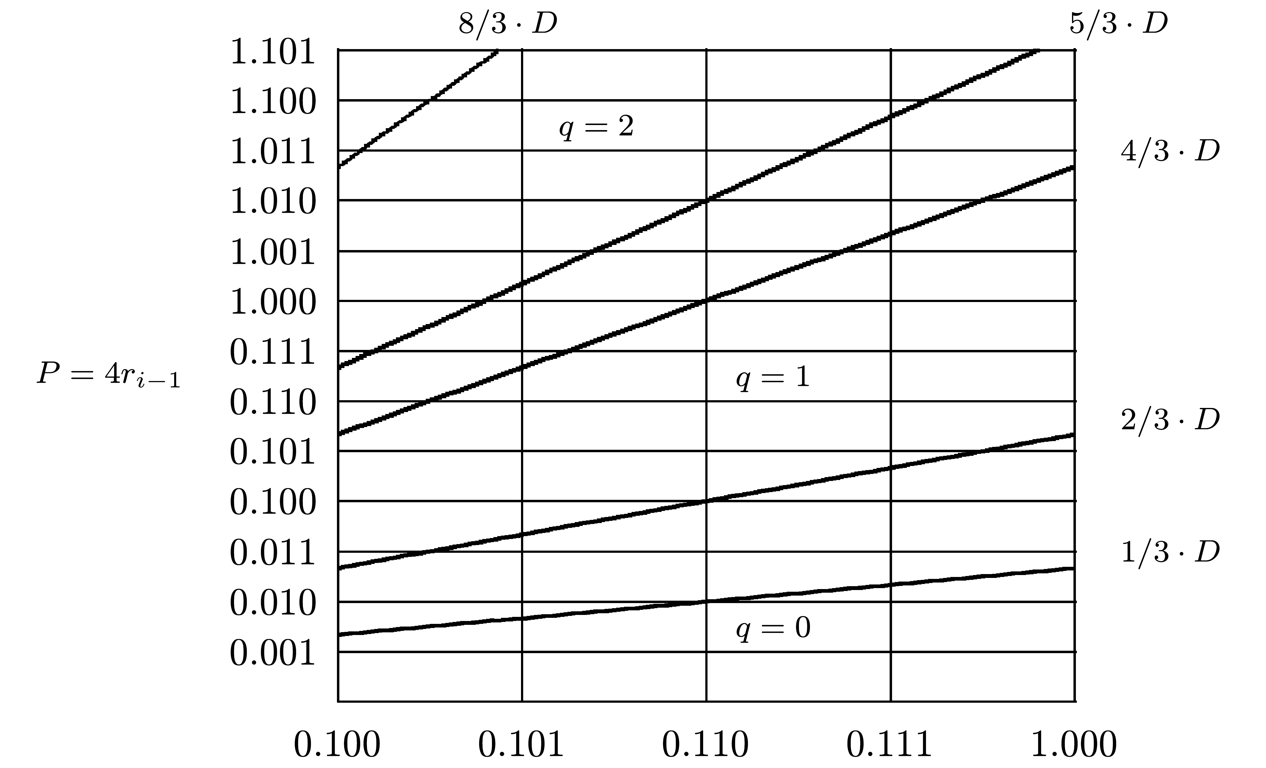
Example: P-D Plot for β=4,α=2,D∈[0.5,1)
Overlapping region for q=1,q=2 - between P=(k+α-1)D=5/3 D and P=(-k+α)D=4/3 D
Single horizontal line?
  (k+1)Dmin=5/6 < (-k+2)Dmax=4/3 - no single line
Smallest horizontal and vertical distances:
  ΔXmin=Dmin⋅5/3⋅3/20=1/8=2 ⇒ εD ≥ 3
  ΔYmin=Dmin⋅1/3=1/6 ⇒ εp ≥ 3
For pair (0.110,.100) - no q legitimate for all points in corresponding rectangle - resolved by εD=4
-3

Slide 30
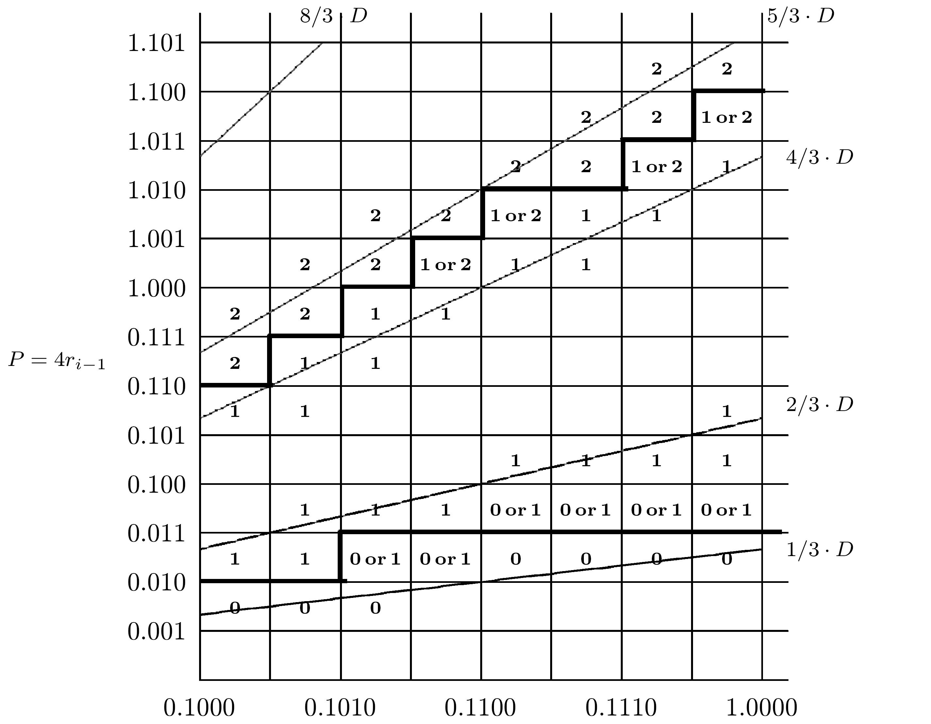
Example Cont.: εp=3 ; εD=4
Heavy lines - one out of many possible separations
Designer can select solution to minimize PLA (look-up table for q)
PLA has ND+NP=4+6 inputs - 3 more bits needed for integer part of remainder and its sign (-8/3 ≥ P ≥ 8/3)
Number of inputs can be reduced to NP+ND-1=9 - most significant bit of D is always 1 - can be omitted
2/3⋅1/2 ≤ 1/3 ⇒ single line possible between q=1,q=0 - requires high-precision comparison of partial remainder - divisor interval partitioned into two subintervals

Slide 31
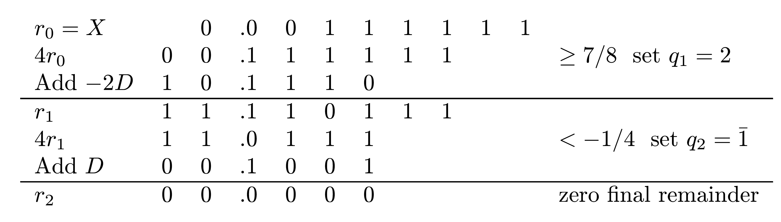
Example
X=(0.00111111)2=63/256 ; D=(0.1001)2=9/16
Comparison constants - 1/4 (0.010) , 7/8 (0.111)
Resulting quotient: Q=0.214=0.10012 =0.01112=7/16
_
_

Slide 32
Numerical Calculation of Look Up Table
Example- start with initial guess εp=εD=3 - attempt to calculate q for D=0.100 and P=0.110 (worst case)
Divisor truncated - consider values from 0.100 to 0.101 ; partial remainder from 0.110 to 0.111
P/D between 0.110/0.101=1.2 (q=1) and 0.111/0.100=1.75 (q=2)
Insufficient precision - increase number of bits of either divisor or partial remainder - try again
Numerical search determining q for each (P,D) pair can be programmed

Slide 33
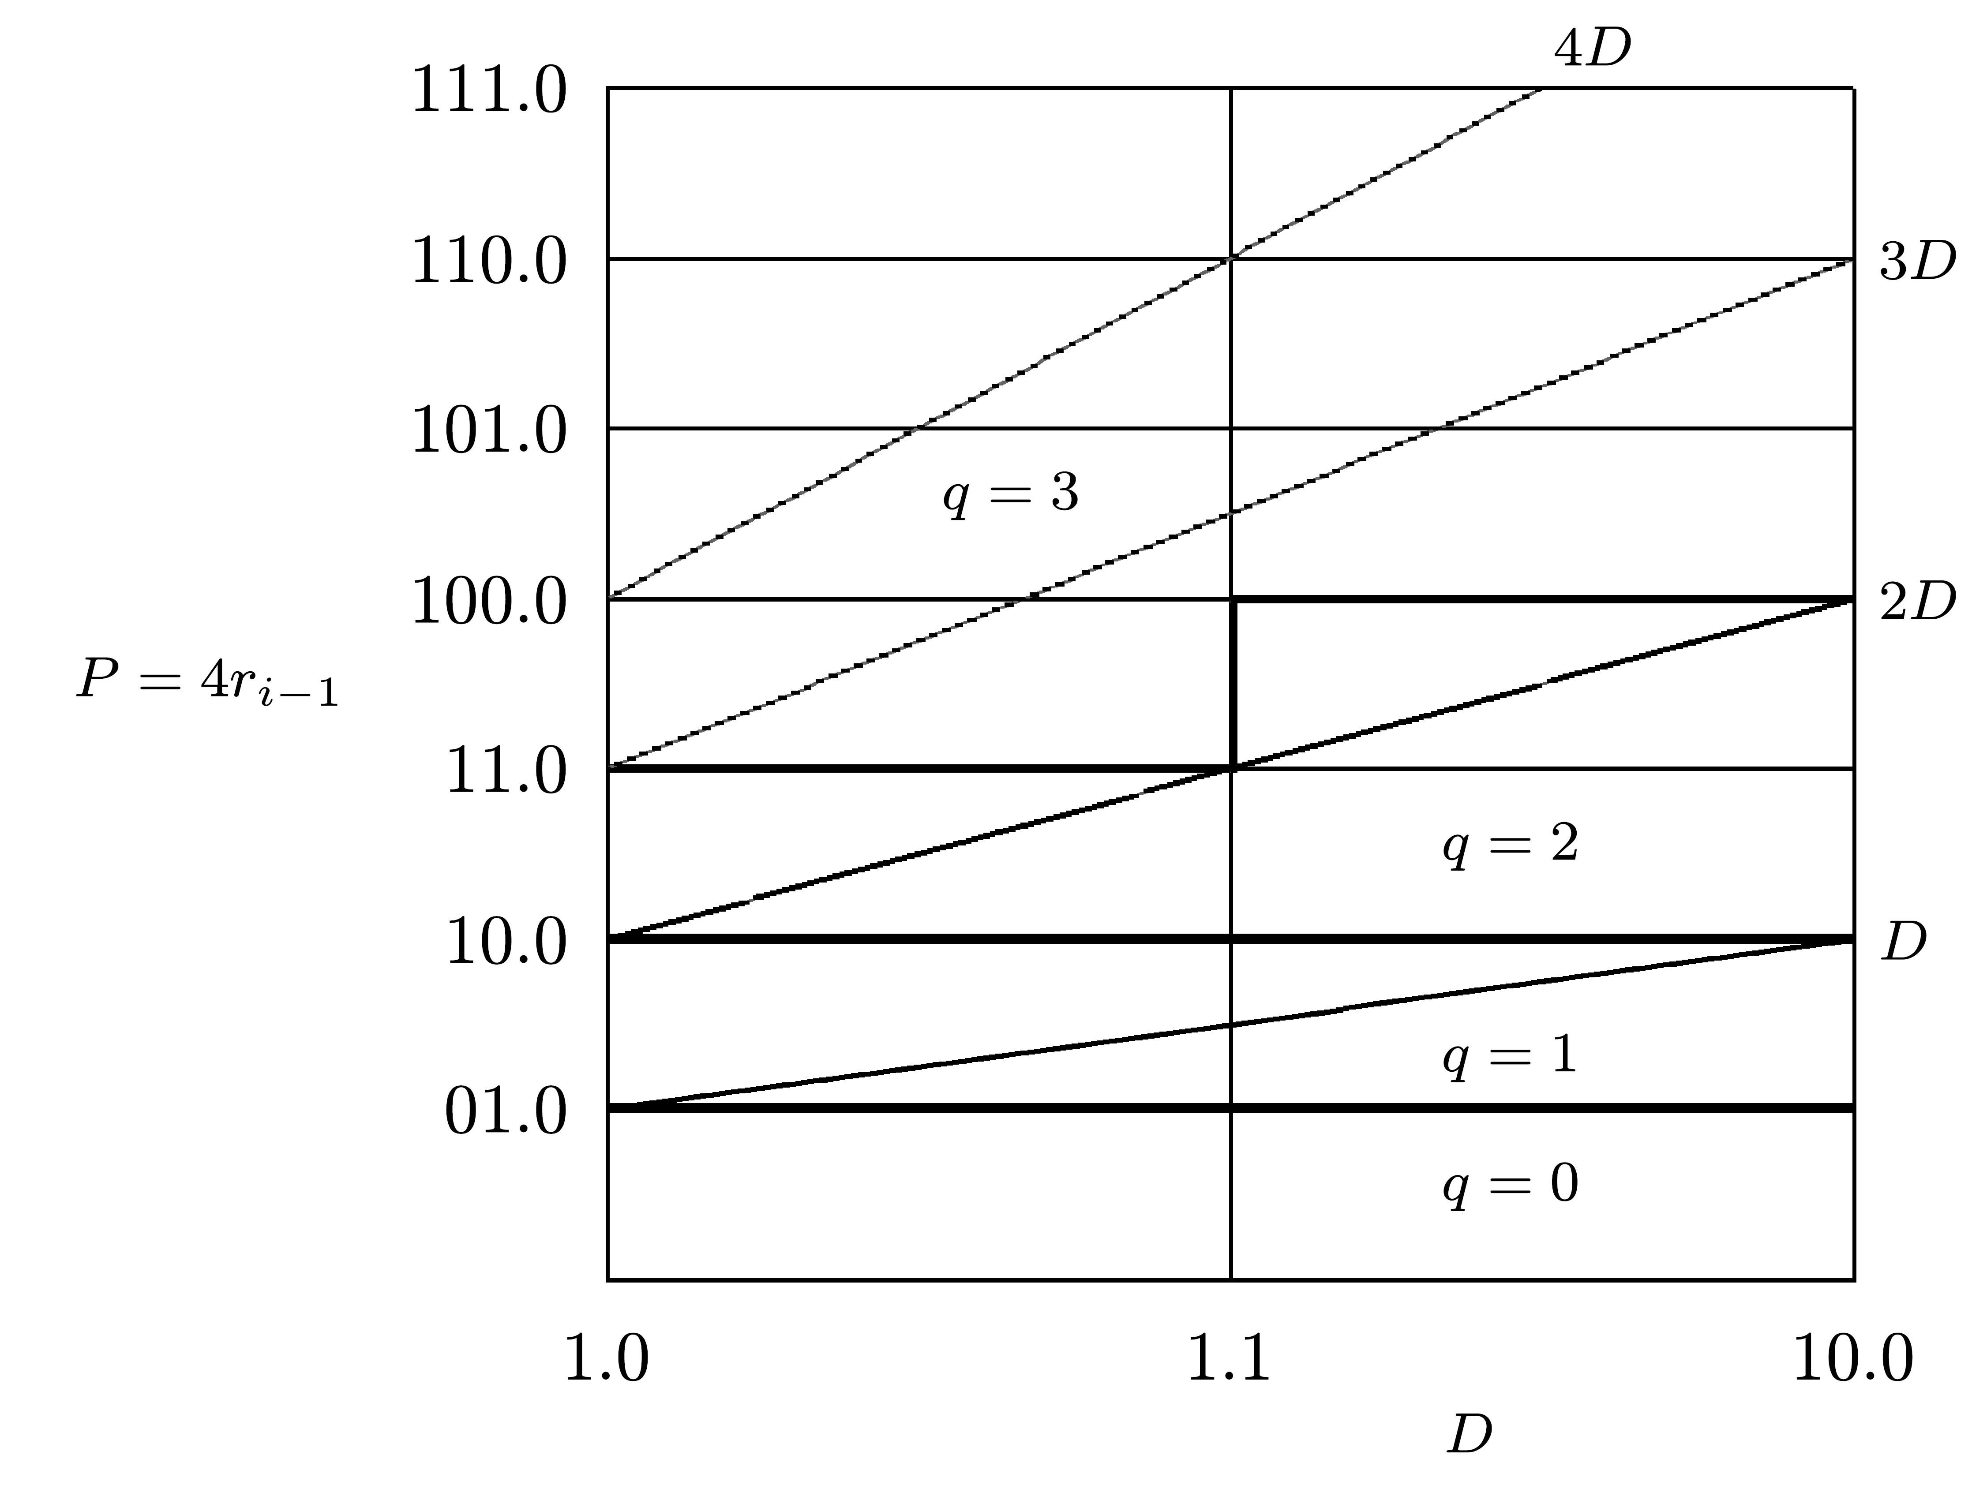
Example - Lower Precision of Higher α
β=4; α=3; k=α/(β-1)=1
Region for q=2 - between P=(k+q)D=3D ; P=(-k+q)D=D
Region for q=3 - between P=4D ; P=2D
Overlapping region - between P=3D and P=2D
For D∈[1,2) (IEEE standard):
  ΔXmin=Dmin⋅3⋅1/6=3/6=2 ⇒ εD ≥ 1
  ΔYmin=Dmin⋅1=1 ⇒ εp ≥ 0
Based on diagram - εD=1 ; εp=0 - ND=2 ; NP=4 instead of ND=4 ; NP=6 for α=2
Simpler quotient selection logic - costly multiple 3D
-1

Slide 34
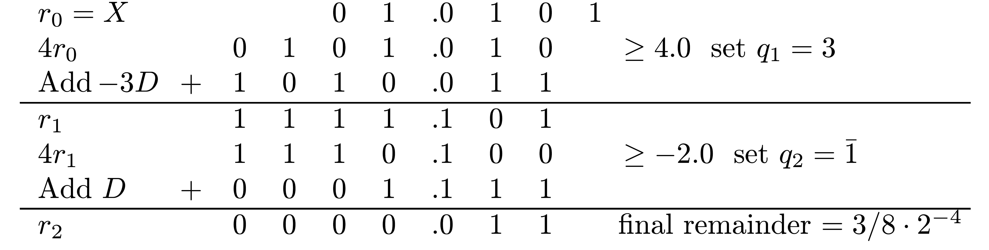
Example
X=(01.0101)2=21/16 ; D=(01.1110)2=15/8
Partial remainder comparison constants - 1,2,4
Quotient: Q=(0.31)4=(0.1101)2 = 11/16
Verification: QD+R = 11/16⋅15/8+3/128 = 168/128 = 21/16=X
_
_

